Slide 1
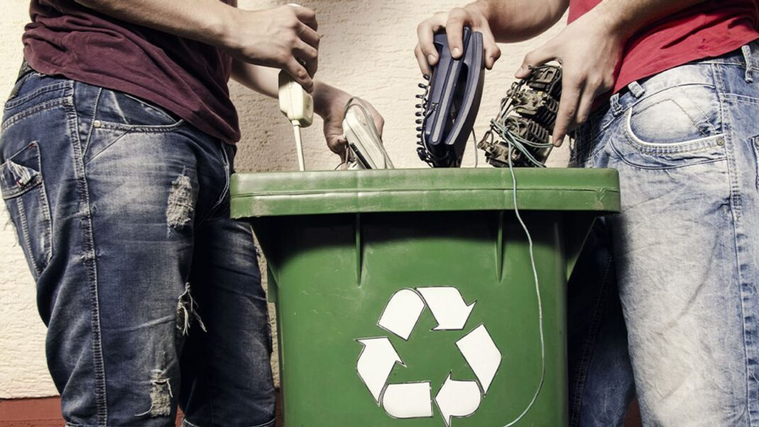
Every Device Deserves a Second Chance
Notes:
Slide 1

Slide 2
E-Waste: A looming Environmental Threat
23kg/ person
50% improper handled
22.3% recycled
E-waste Finland
Doubles 10~15 years
Global Impact
Environmental
Impact
Hazardous Recycling
Toxic Contamination
$57 billion
Inadequate Infrastructure
Frequent updates and short lifespan
Notes:
Slide 2

Slide 3
E-Waste: A looming Environmental Threat
50% improper handled
Environmental
Impact
22.3% recycled
23kg/ person
Toxic Contamination
E-waste Finland
Global Impact
Doubles 10~15 years
Hazardous Recycling
Frequent updates and short lifespan
$57 billion
Inadequate Infrastructure

Slide 4
E-Waste: A looming Environmental Threat
22.3% recycled
50% improper handled
Global Impact
23kg/ person
Hazardous Recycling
Environmental
Impact
E-waste Finland
Toxic Contamination
Doubles 10~15 years
Frequent updates and short lifespan
Inadequate Infrastructure
$57 billion

Slide 5


AI-POWERED RECYCLING AND REPURPOSING OF E-WASTE
As simple as it gets
Notes:
Slide 3

Slide 6
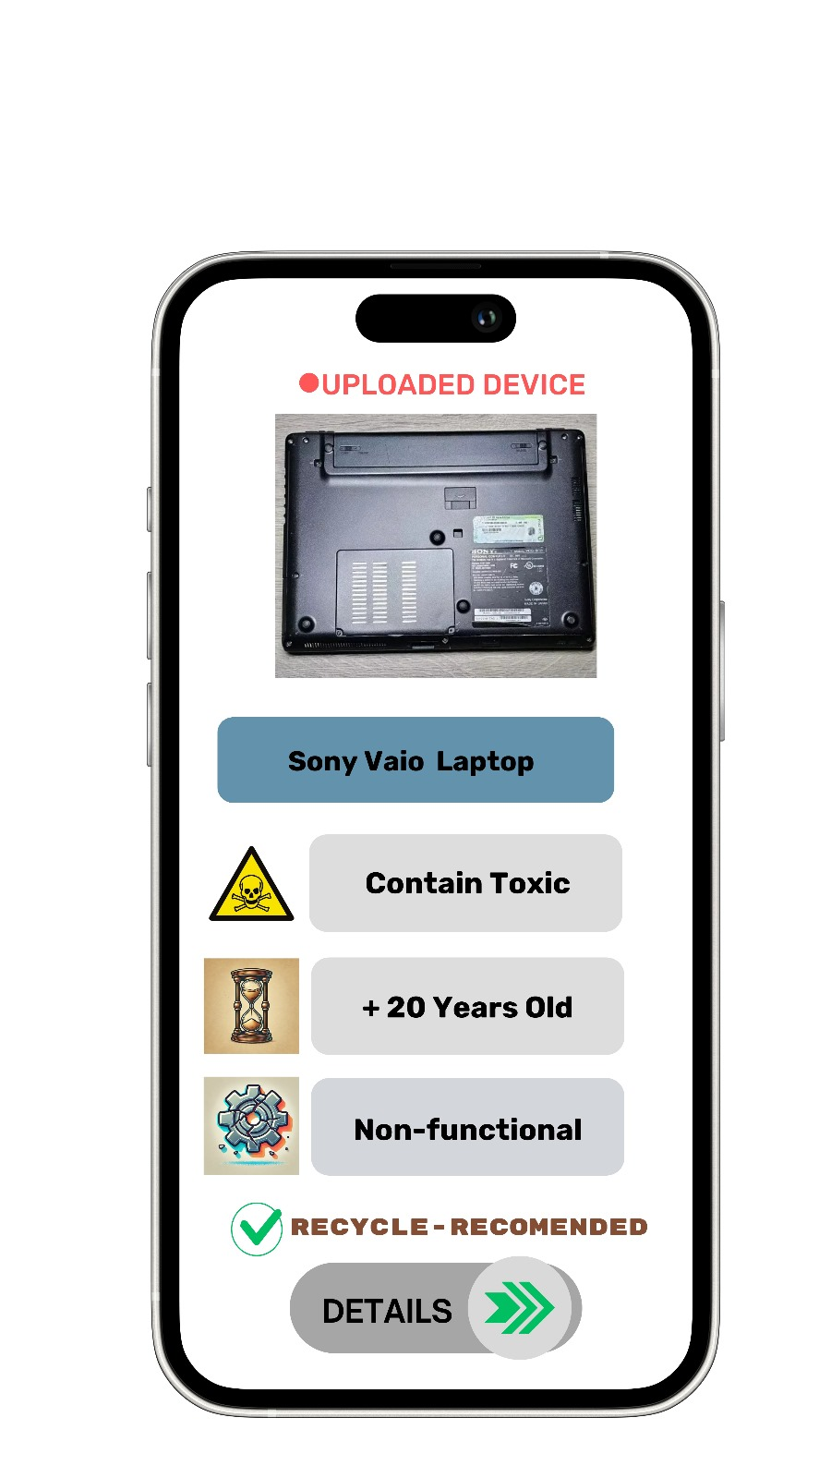

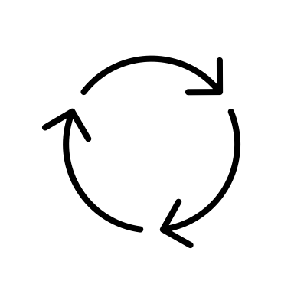
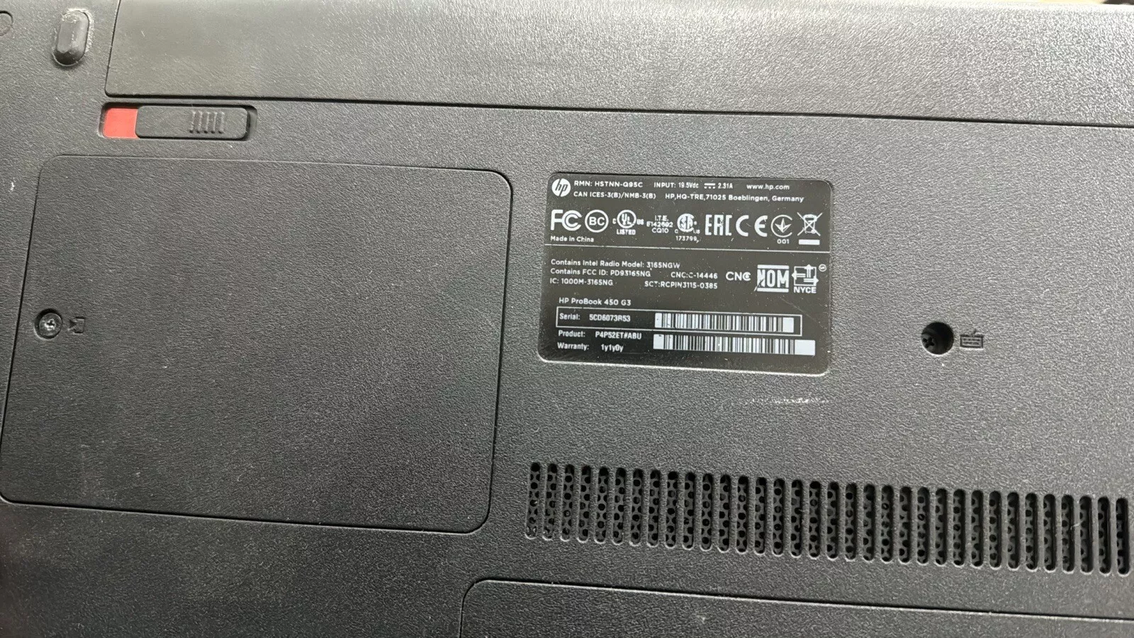

Easy Fix for a Big Issue
Processing
Recommendation
Analysing
Input
Analyzing your device
Notes:
Product introduction
Slide 4

Slide 7
Features
Image based analysis
Educational Insights
Personalized Recommendation
Features
All In One
Integration
Notes:
Slide 5

Slide 8



Positive Impacts
Environmental Sustainability
80% energy saved
Resource Conservation
50%
E-Waste landfills
Circular Economy Advancement
Resource Circularity
Data-Driven Decision-Making
Social Impact
Responsible Consumption
Convenience and Accessibility
Regulatory Goals
Notes:
Slide 6

Slide 9
Revenue
Early Adopters
Recycling company
Corporate Organization
Government Organization
Why Choose Us
End to End Solution
Increasing User Engagement
Data Driven Solution
Organizational Efficiency
Notes:
Slide 7
3 sectors for revenue
Recycle company can collect the devices enourmously and send them to the 3rd party
Better management of e waste in finland for the e waste management companies
Recycle to mining
Corporate organization eg. ernstromgruppen

Slide 10
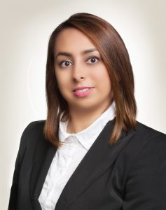
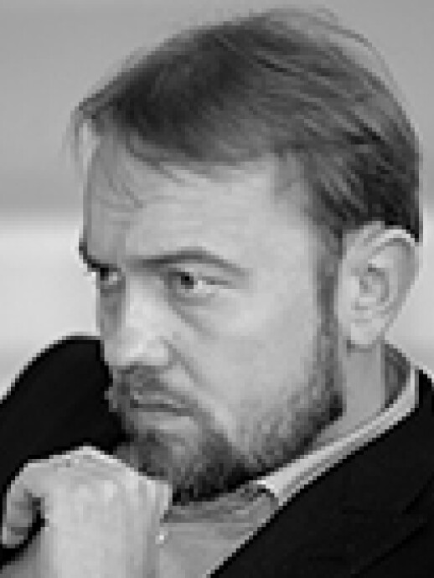
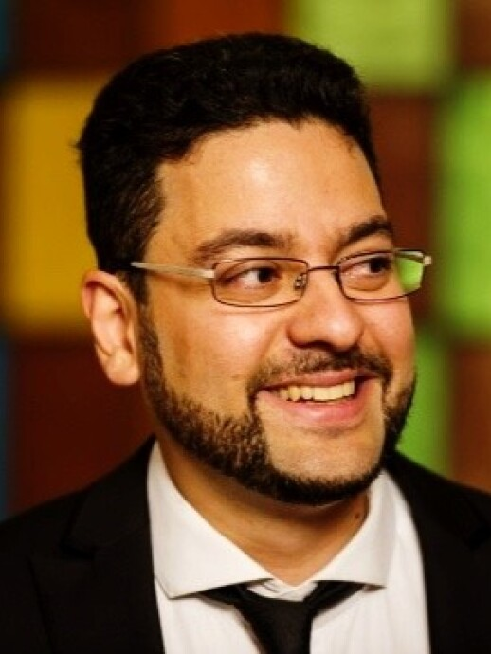
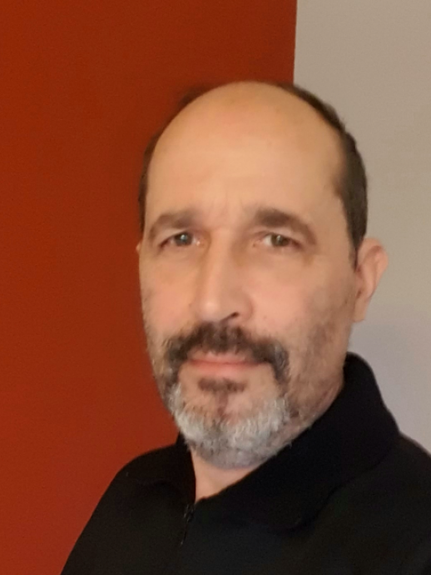

Experts supporting our innovation
Feedback from Deep Learning Experts
Endorsement from Business Development Professionals
 | Fahimeh Farahnakian fahfar@utu.fi
 | Pouya Jafar Zadeh pouya.jafarzadeh@utu.fi
 | This not only an effective and scalable solution that has a great impact in boosting the circular economy of electronic waste. It has also a great impact in generating more effective market for valuable recycled materials. Kaapo Seppälä
 | Antero Lake akjarvi@utu.fi
Alignment with European Union Initiatives
Notes:
Slide 9
validation

Slide 11
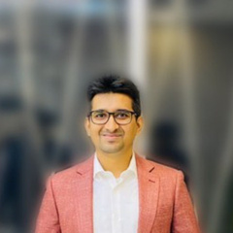
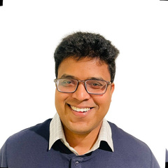
A Team with Experience and Expertise
Automation, IoT, AI/ML,
Co founder of ison 3d
PM, AI, ML, Vision, Startup
Mahmudul
Monzurul
Our Direction
Developing AI-driven applications that promote sustainability and establish the solution as a startup.

Slide 12
A Team with Experience and Expertise
PM, AI, ML, Vision, Startup
Automation, IoT, AI/ML,
Co founder of ison 3d
Thank You
Mahmudul
Monzurul
Our Direction
Developing AI-driven applications that promote sustainability and establish the solution as a startup.

